Slide 1

Presented by:
Mohammad Rayyan.
Pragathi Sindole.
Embadi Anvesh.

Slide 2

Amazon is a vast internet-based enterprise that sells books, music, movies, housewares, electronics, toys, and many other goods.
In this article, we will explore the react hooks and context API as we build the amazon clone using the react context API for state management within our app.
If you want to learn about react native animation, then use this brilliant guide.

Slide 3
Pre-requisite
Basic understanding of JavaScript ES6
Basic understanding of HTML and CSS
Have Nodejs installed on your machine
Technologies
React
Firebase
Font awesome (icons)

Slide 4
Project overview
Our clone will allow users to register, login, add products to the shopping cart, remove product from the shopping cart.
Our clone will permit only an authenticated user to access the home page.

Slide 5
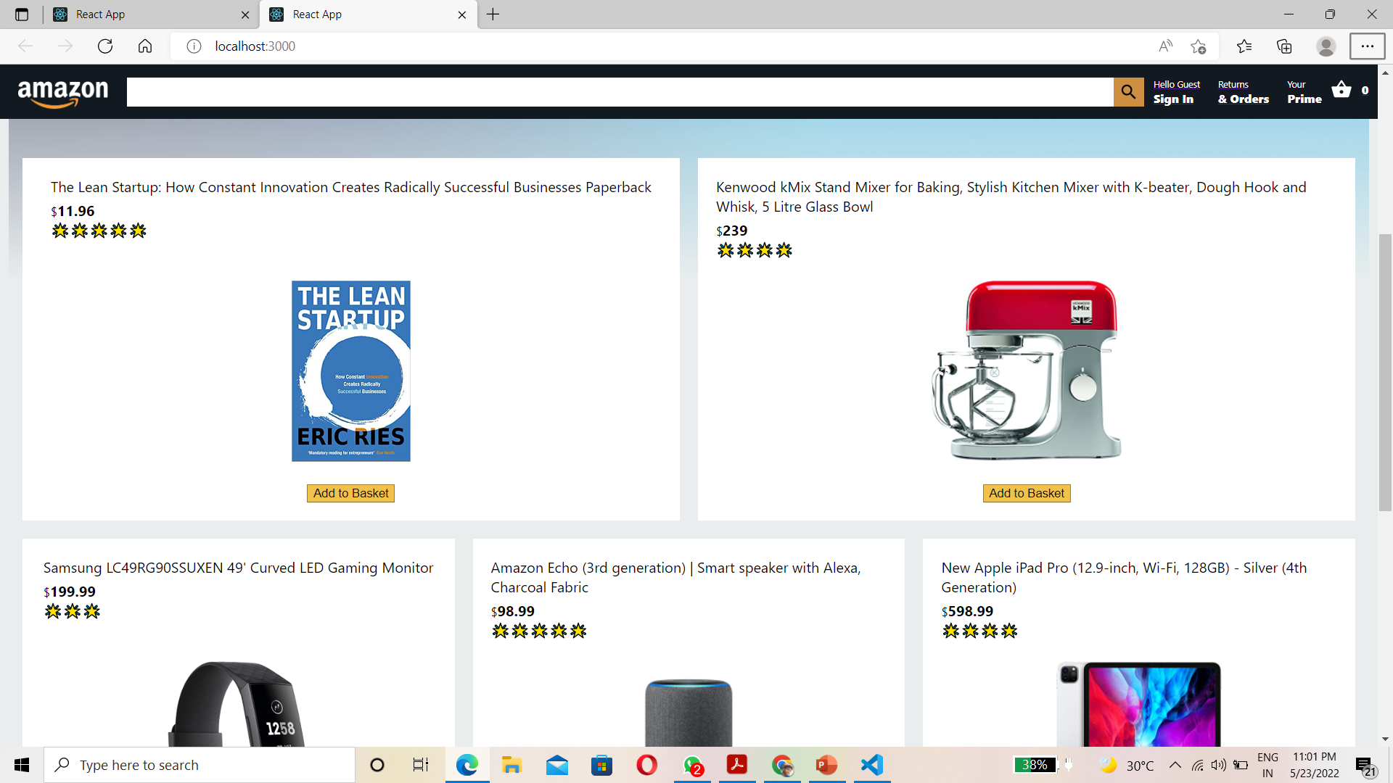

Slide 6
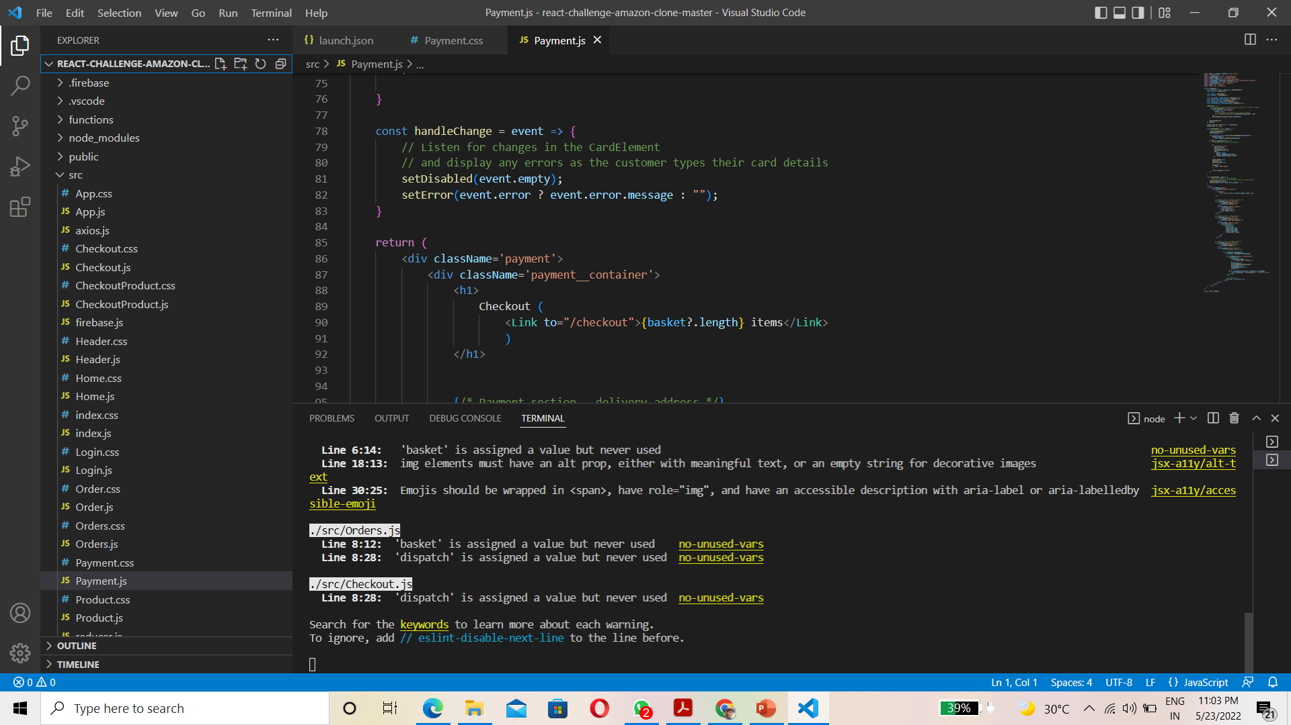

Slide 7
Project setup
Let’s get started as we create a new project using the create-react-app so go to a directory where you will store this project and type the following in the terminal
create-react-app amazon-clone
The above command uses the create-react-app CLI tool to generate a react boilerplate project for us so that we don’t have to configure any tooling.
For the command above to work, the create-react-app CLI tool must be installed globally using the command below.
npm install -g create-react-app

Slide 8
Spin up the server with the following:
cd amazon-clone
npm start
Setting up Firebase
In this project, we will use firebase for user authentication.
Firebase is provides developers with servers, APIs and datastore, all written so generically that developers can modify it to suit most needs.
It is user friendly In this article we will use the firestore to store our data.
Head to fiarebase.google.com and sign up.
It is free for small projects.

Slide 9
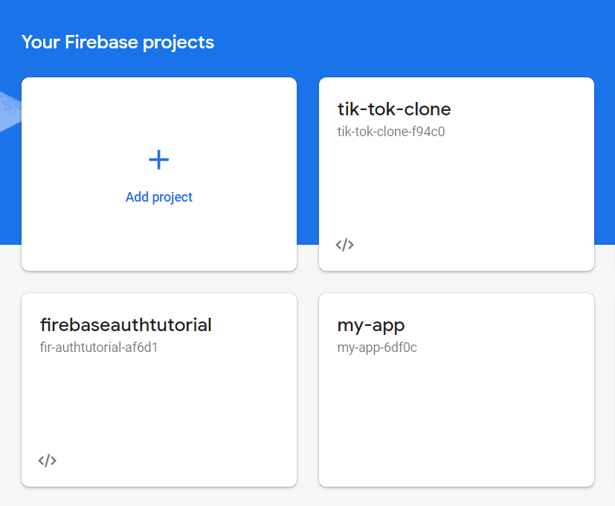

Slide 10
Components
Our amazon clone will consist of the following components:
Header
Login
Product
Subtotal
Checkout
Home

Slide 11
Header Component
The header comprises of the amazon logo,search field,cart icon and the number of items in the user’s basket.
If a user is logged in,he will have these Hello user@gmail.com and
Sign Out text on his header component.
Otherwise,he will have Hello and sign in

Slide 12
Add Products to Basket:
In order to add product to the basket, the context API provides us with the dispatch method which dispatches actions to the reducer.
CheckoutProduct Component
This component receives the product’s information from the checkout component as props, and displays it on the browser. It also allows the user to remove products from the basket. In checkoutProduct folder, create CheckoutProduct.js file

Slide 13
In login folder create Login.css component
Login Component
This component uses the firebase auth module to sign up new users and also verify the sign up users each time they sign in.
In login folder create login.css component.
Now we can checkout the features we have implemented so far in our amazon clone.
Npm start

Slide 14
Future Scope:
We will add some other features to the app Payment Gateway IntegrationEncourage your customers with just a few clicks to pay for the shopping.
Customers must connect credit / debit cards, bank account information to the payment gateway and it will enable them to make the order payment.
Augmented Reality (AR) ViewAllow your customers to display products in their homes before purchasing them through the AR display feature.
Customers can see how every product looks at the particular location in the house.

Slide 15
Push Notifications
Catch the attention of your customers by notifying them of the latest offers, discount deals and new selection of items.
Stay linked to them via updates and reminders.
Social Media Integration
Using social media channels such as WhatsApp, Facebook, Instagram and more, consumers share their favorite products, wish list items and purchased goods directly with their friends and family members.

Slide 16
Conclusion
That’s it! We have succeeded in building our amazon clone using the context API for state management and firebase for user authentication.

